Slide 1
Business Intelligence G. Mudare
Notes:
Introduce yourself to the students and also find out there names
Have them give you in 30 seconds a summary of who they are and what there interest in IT is

Slide 2
Data Mining
Functionalities

Slide 3
Clustering
Similar to classification, clustering is the organization of data in classes.
Unlike classification, in clustering, class labels are unknown and it is up to the clustering algorithm to discover acceptable classes.
Clustering is also called unsupervised classification, because the classification is not dictated by given class labels.
Clustering approaches are based on the principle of
Maximizing the similarity between objects in the same class (intra-class similarity)
minimizing the similarity between objects of different classes (inter-class similarity).

Slide 4
Example
Cluster analysis.
Performed on Electronics customer data to identify homogeneous subpopulations of customers.
To identify target groups for marketing

Slide 5
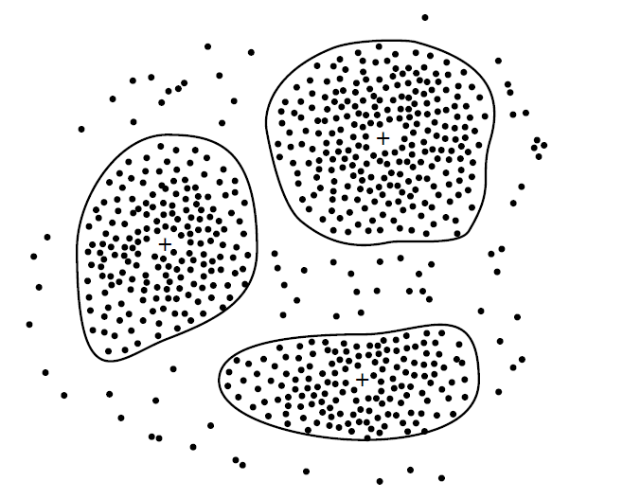
Customer data with respect to customer locations in a city,
. Each cluster “center” is marked with a “+”

Slide 6
Outlier analysis:
Outliers are data elements that cannot be grouped in a given class or cluster. (exceptions or surprises)
Although outliers can be considered noise and discarded in some applications, they can reveal important knowledge in other domains, and thus can be very significant and their analysis valuable. eg In fraud detection
The analysis of outlier data is referred to as outlier mining.

Slide 7
Example
Outlier analysis. Outlier analysis may uncover fraudulent usage of credit cards by detecting purchases of extremely large amounts for a given account number in comparison to regular charges incurred by the same account.
Outlier values may also be detected with respect to the location and type of purchase, or the purchase frequency.

Slide 8
Evolution Analysis
Data evolution analysis describes and models regularities or trends for objects whose behaviour changes over time.
May include characterization, discrimination, association and correlation analysis, classification, prediction, or clustering of time related data,
Distinct features of analysis include:
Time-series data analysis,
Sequence or periodicity pattern matching,
similarity-based data analysis.

Slide 9
Example
Suppose that you have the major stock market (time-series) data of the last several years available from the a Stock Exchange and you would like to invest in shares of high-tech industrial companies.
A data mining study of stock exchange data may identify stock evolution regularities for overall stocks and for the stocks of particular companies.
Such regularities may help predict future trends in stock market prices, contributing to your decision making regarding stock investments.

Slide 10
Are all of the Patterns interesting?
A data mining system has the potential to generate thousands or even millions of patterns, but only a small fraction of the patterns potentially generated would actually be of interest to any given user.

Slide 11
What makes a pattern interesting?
Easily understood by humans,
Valid on new or test data with some degree of certainty,
Potentially useful,
Novel.
A pattern is also interesting if it validates a hypothesis that the user sought to confirm.
An interesting pattern represents knowledge.

Slide 12
Identifying and measuring the interestingness of patterns and rules discovered, or to be discovered, is essential for the evaluation of the mined knowledge and the KDD process as a whole.
rule support, of the form X →Y representing the percentage of transactions that the given rule satisfies taken to be the probability
P(X UY),where XUY →a transaction contains both X and Y, that is, the union of itemsets X and Y
confidence, which assesses the degree of certainty of the detected association.
This is conditional probability P(Y/X), i.e . the probability that a transaction containing X also contains Y.

Slide 13

Measures of pattern interestingness
, support and confidence are defined as
Each interestingness measure is associated with a threshold, which may be controlled by the user.
For example, rules that do not satisfy a confidence threshold of, say, 50% can be considered uninteresting.
Rules below the threshold likely reflect noise, exceptions, or minority cases and are probably of less value.

